Slide 1
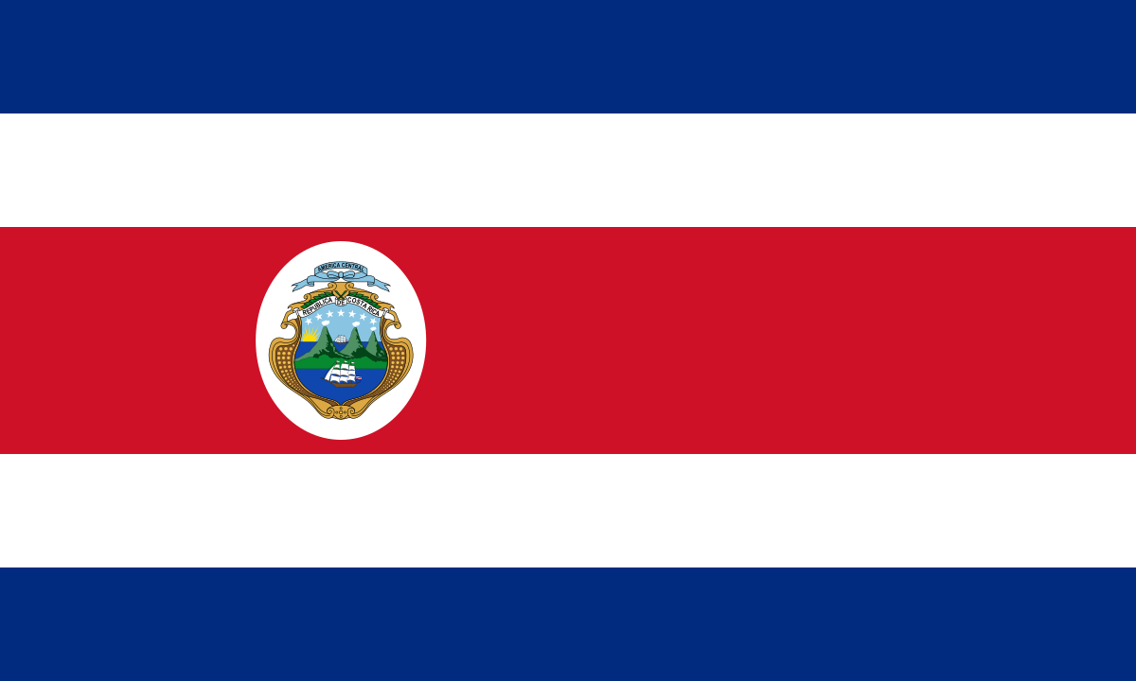
Costa Rica
Ali Meihls

Slide 2
Facts
  Population → 4.7 million
    Urban population → 64.7%
    Only about 1% of the population are of indigenous heritage
Military → No military forces
GDP per capita → $12,900
Capital → San José
Costa Rica translates to → “Rich Coast”
  Spaniard Gil Gonzalez Davila named the country because the inhabitants wore golden bands in their noses and ears

Slide 3
History
September 18th 1502 Christopher Columbus was on his 4th voyage to the New World when he anchored off shore
There were four indigenous tribes already inhabiting the island.
  The Caribs on the east coast, and the Borucas, Chibchas and Diquis in the southwest.
Little to none of these inhabitants lasted following the Spanish taking over the colonies.
  Spainards brought deadly smallpox to the island, killing thousands

Slide 4
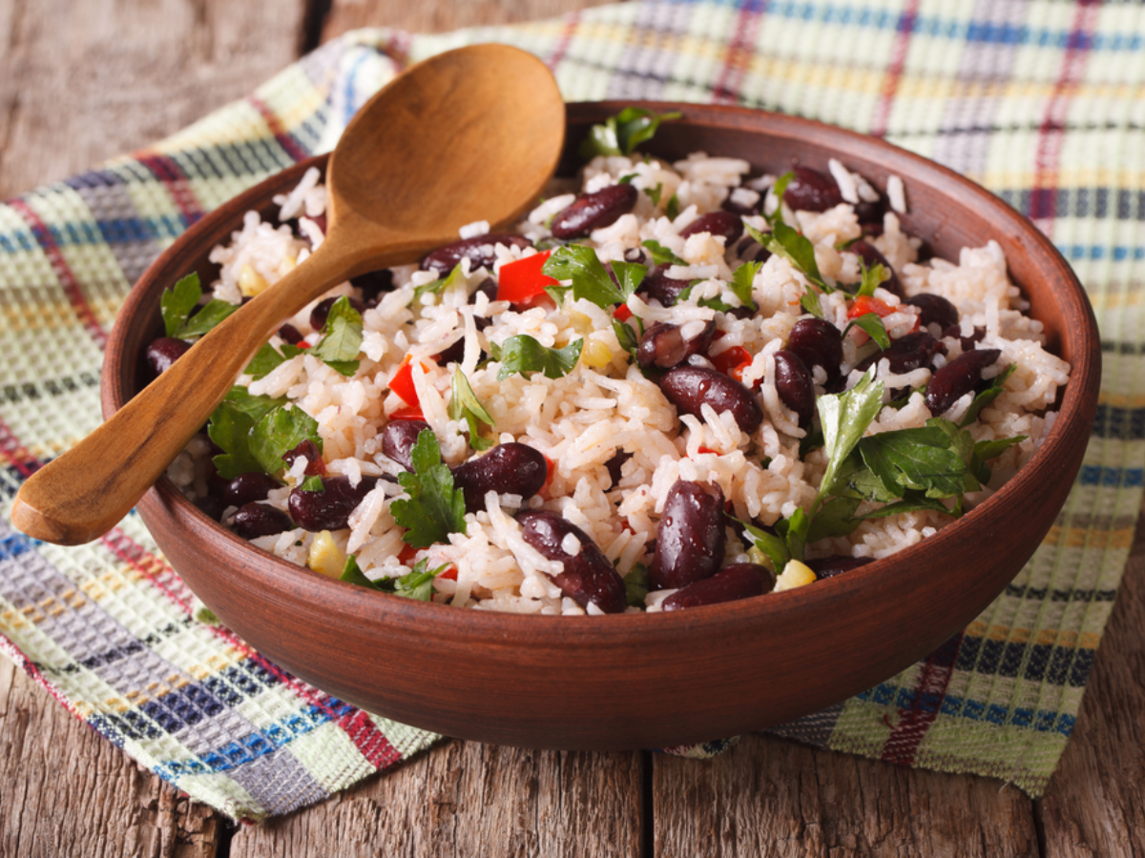
Food
Gallo Pinto “spotted rooster” – breakfast dish composed of rice and beans, sometimes mixed with onion, peppers and cilantro. Received its name because of how the rice and beans look when they’re mixed together, giving off a speckled/spotted look.

Slide 5
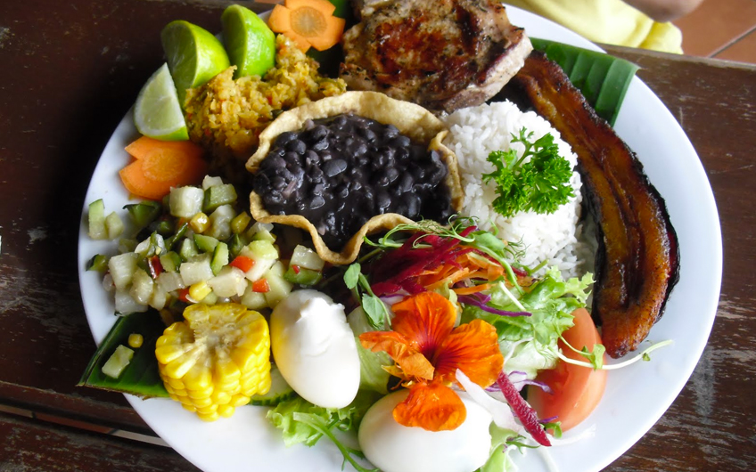
Food
Casado “married man”- it is believed that the name came about because of men wanting to eat as they did at home while working and eating out. It is a dish that is actually made up of a variety of foods, including rice, black beans, meat or fish, tortilla, plantains and a salad.

Slide 6
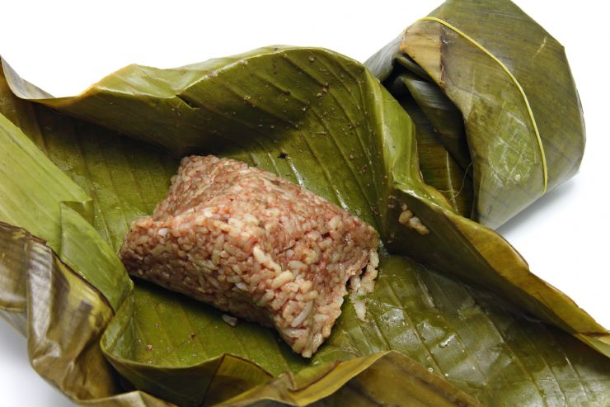
Food
Tamales- while they may resemble the Mexican tamale, they are actually very different. Costa Ricans love garlic, and tend to go really easy on all other spices, and instead of a corn husk wrapping, they use banana leaves.

Slide 7
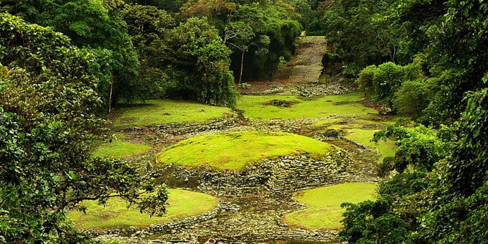
Architecture
Unfortunately Costa Rica lacks the large, pre-Columbian ruins that the rest of Mesoamerica has. As well as the lack of well-preserved, colonial-era cities that most of Latin America has.
There are some petroglyphs and dwellings in Guayabo

Slide 8
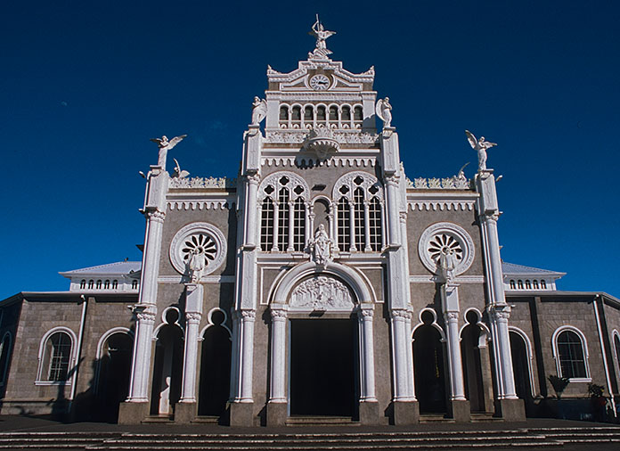
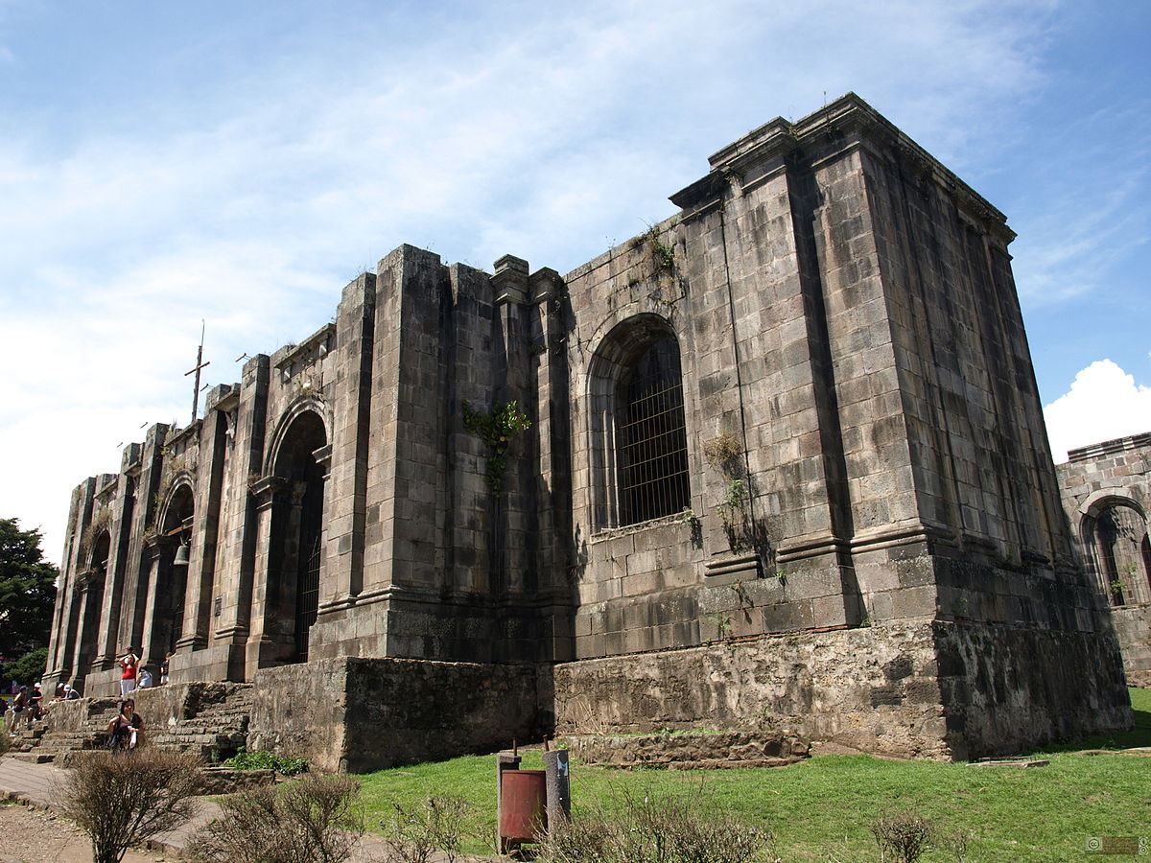
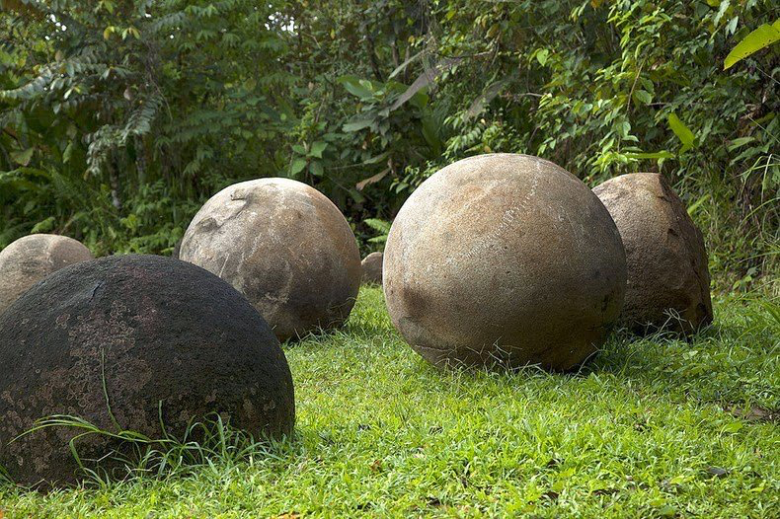
Architecture
Basílica de Nuestra Señora de los Angeles
Cartago Ruins
Stone Spheres of Costa Rica- one of the strangest mysteries
Santiago Apóstol Parish Ruins

Slide 9
Holidays
April 11: Juan Santamaria Day
  Battle of Rivas in 1856 against U.S citizen William Walker who sought to turn Costa Rica into a slave-trade empire. Juan Santamaria was a young drummer boy who set fire to a hostel, killing himself and a large amount of Walkers troops, leading to Costa Ricas win.
July 25: Annexation of Guanacaste Day
  Celebrates the annexation from Guanacaste province in 1824
Aug 2: Patron Saint Day
  Honors the patron saint, Virgen de los Angeles (Virgin of the Angels)
Sep 15: Independence Day
Nov. 2: All Soul's Day
  Also known as day of the dead

Slide 10
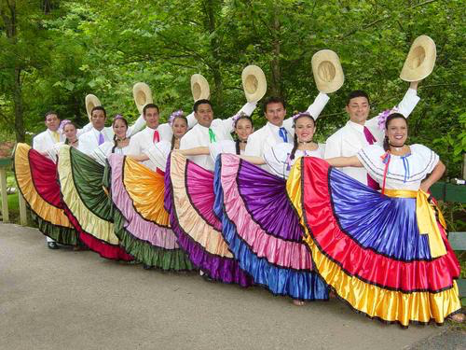
Music
Many of the musical traditions go back to colonial times when the Spaniards brought European music with them.
Folk music was big in Costa Rica, it was a combination of Spanish beats with indigenous tempos.
When it comes to dancing, Costa Ricans prefer the traditional Latin salsa.

Slide 11
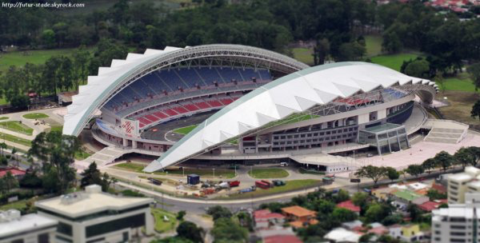
Sports
Soccer
  National stadium was gifted to Costa Rica by China.
  Estadio Nacional de Costa Rica

Slide 12
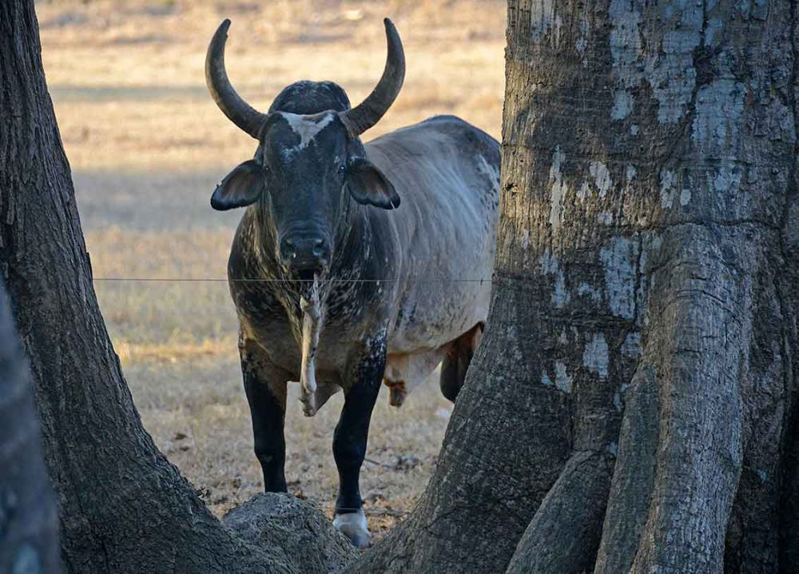
Sports
Bullfights- more like a rodeo, and accompany most fiestas. The main one, Zapote, is the equivalent of the Super Bowl for Costa Rica.
Children grow up learning about Malacrianza,which means “badly raised”. He was a bull known for not only tossing riders from his back, but killing them, even though it was only 2 deaths.
  One killed in an accidental fall, the other killed by the bulls horn.

Slide 13
Expressions
Ticos- Costa Ricans
Pura vida- “pure life”
  Many meanings such as “fantastic”, “you’re welcome”, “thank you” and “nice to meet you”
Mae – “dude”
Brete- “work”
Media naranja- “half orange”
  Used to describe someone's other half, or soul mate
Mejenga- friendly, informal soccer game
Salado – tough luck
Tuanis – “awesome”

Slide 14
References
http://www.geographia.com/costa-rica/history.htm
https://www.govisitcostarica.com/blog/post/most-popular-foods-costa-rica.aspx
http://www.frommers.com/destinations/costa-rica/in-depth/art--architecture
https://www.costarica.com/culture/costa-rican-music/
http://www.ticotimes.net/2014/04/11/what-is-juan-santamaria-day-photos-and-an-explanation-of-costa-ricas-celebration-of-its-only-war-hero
http://www.travelandleisure.com/local-experts/costa-rica/popular-sports-costa-rica
https://matadornetwork.com/abroad/23-essential-expressions-learn-visiting-costa-rica/

